Slide 1
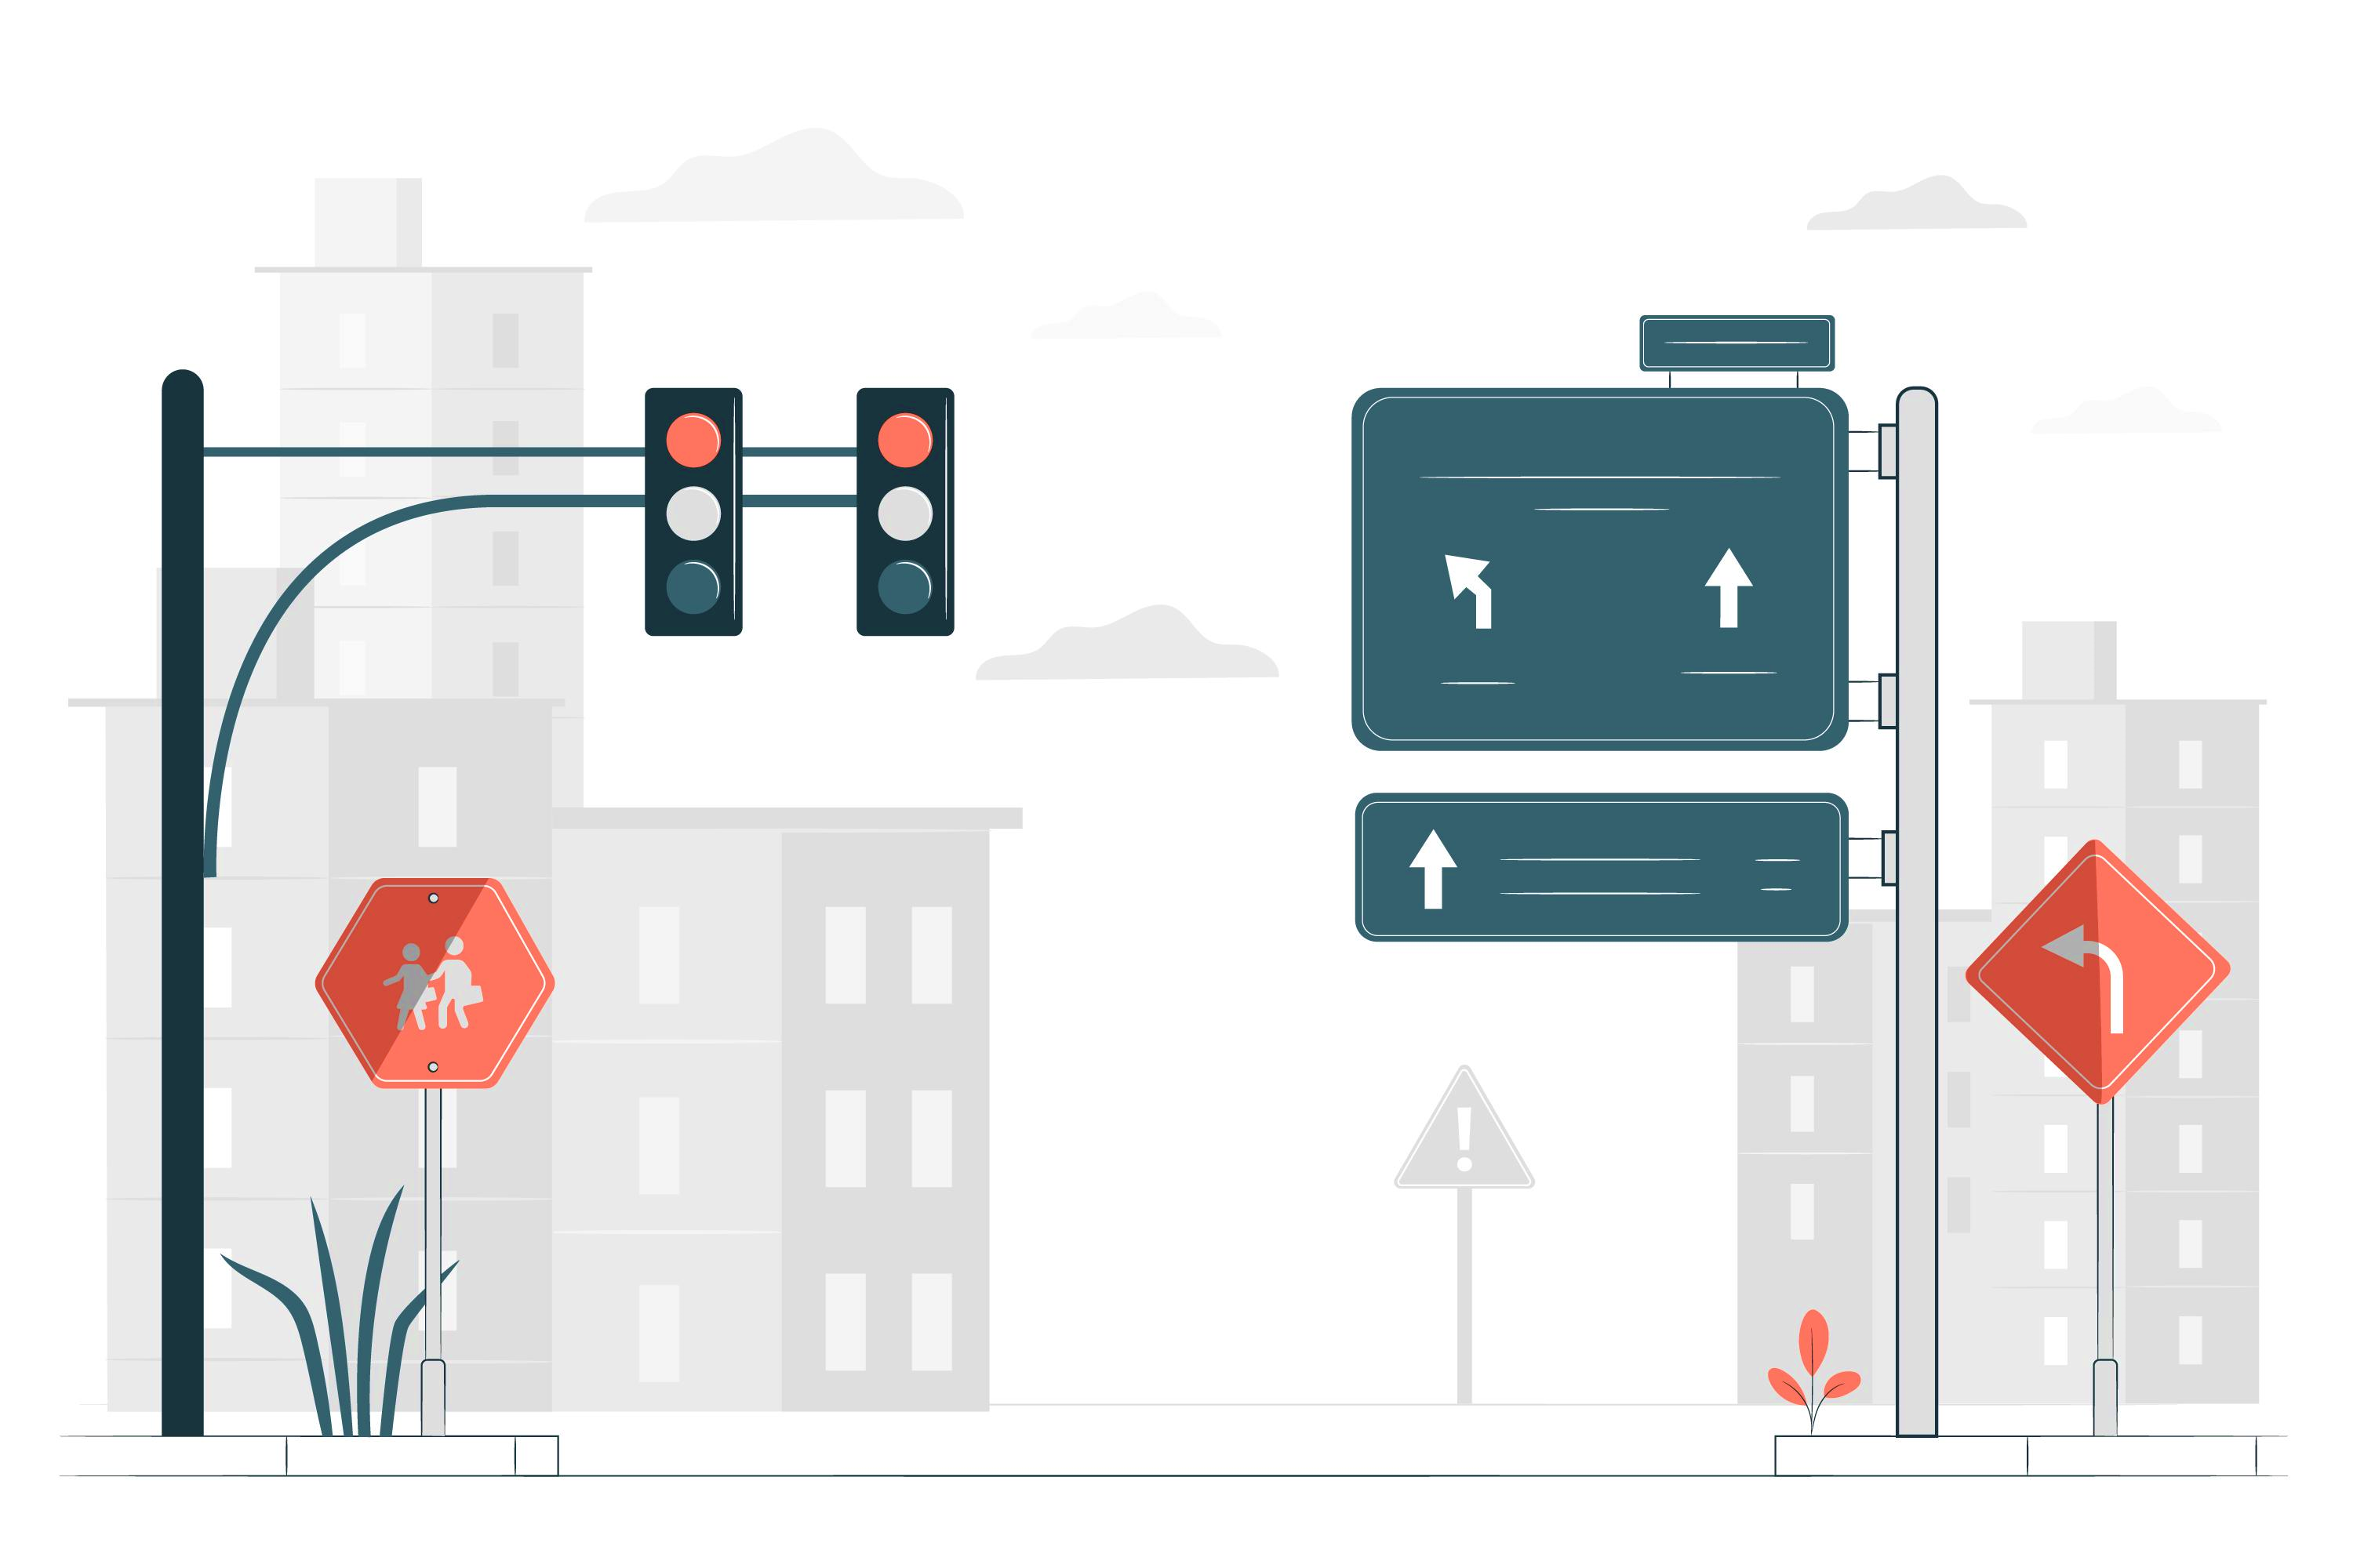
Evaluating automated traffic violation detection system for road safety improvement
24 – 25J - 165

Slide 2
Our Team
 | Name | Student ID
1 | Mahindapala G.H.N.K | IT21327926
2 | Seneviratne K.A.C.M | IT21212222
3 | Wathsala W.H.D | IT21334306

Slide 3
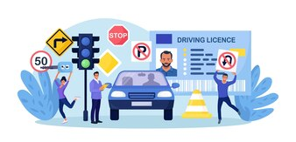
Introduction
Road traffic violations like red-light running, stop-line crossing, and pedestrian crossing violations contribute to accidents and congestion.
Manual enforcement is slow
and limited in scope.
Our system aims to automate detection
and report violations in real time
using camera-based
monitoring and rule-based
computer vision.

Slide 4

Research Problems
Inconsistent detection due to human
error and limited camera angles.
Delayed enforcement due to manual
processes.
Low scalability of traditional systems.
Lack of organized data for analysis
and reporting.

Slide 5
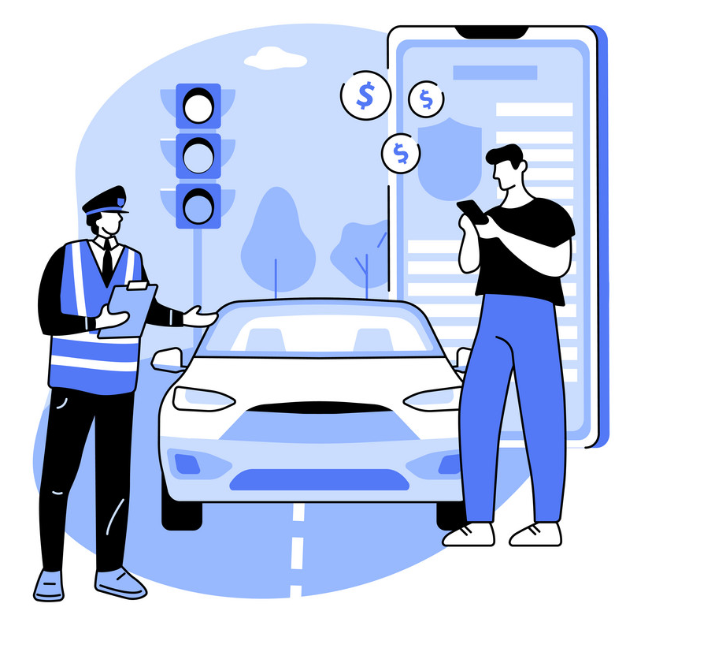
Main Objective Develop an automated rule-based traffic violation detection system using video surveillance and computer vision to detect red-light, stop-line, and pedestrian crossing violations.
Sub Objectives
Detecting violation from Primary & Secondary camera system.
Identifying the vehicle & vehicle type
Analyse the traffic and display on LED Screen
Maintaining profiles and report the details to police station.

Slide 6
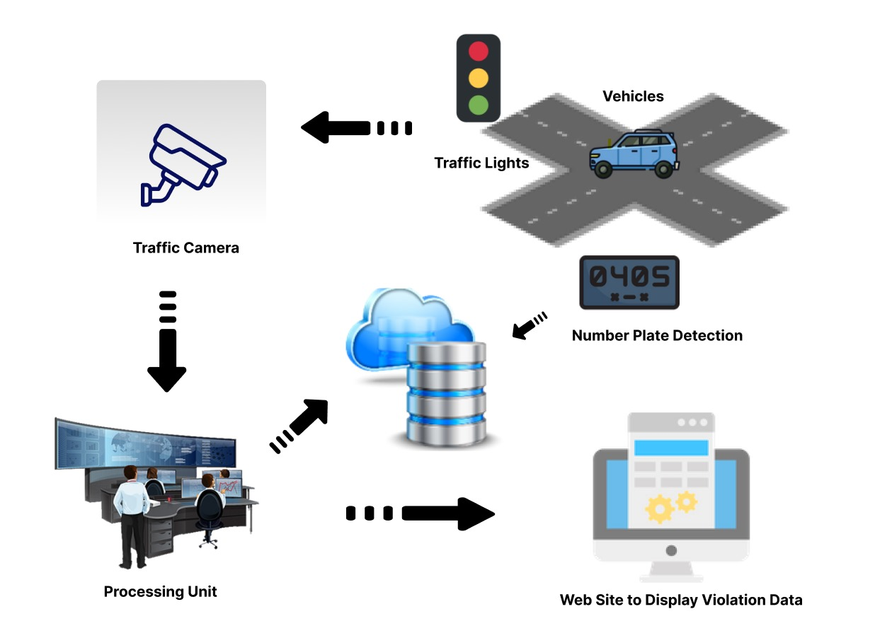
System Diagram

Slide 7

IT21212222 | Seneviratne.K.A.C.M
BSc (Hons) Degree in Information BSc (Hons) Degree in Information Technology
Specialized in Information Technology
IT21212222 | <<Seneviratne.K.A.C.M>> | <<24-25J-165>>

Slide 8
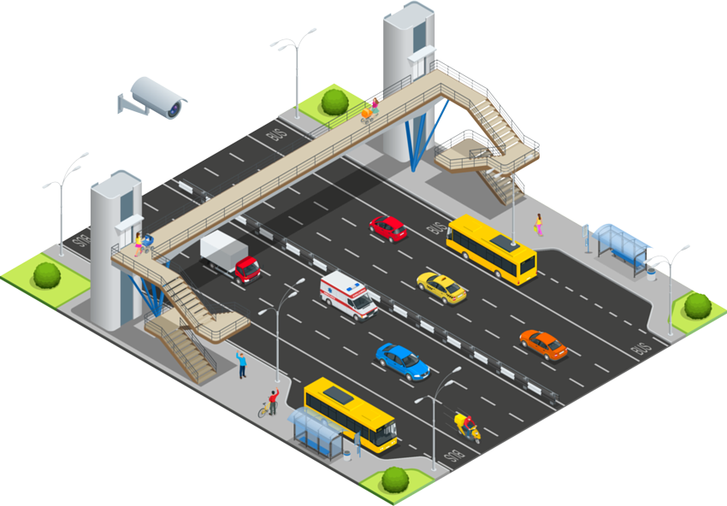
Background
Specialized in rule-based image processing techniques.
Developed the red-light violation detection system.
Experienced in detecting traffic light
signals and monitoring vehicle movement.
Skilled in synchronizing camera inputs with
traffic light status for accurate detection.
Worked on optimizing algorithms for
real-time violation monitoring.
IT21212222 | <<Seneviratne.K.A.C.M>> | <<24-25J-165>>

Slide 9
Objective
To develop an advanced traffic monitoring system that accurately identifies red-light running and invalid stop line crossings using a main camera system enhanced with computer vision and machine learning technologies.
Sub-Objectives
Detection Model Development
Real-time Processing
IT21212222 | <<Seneviratne.K.A.C.M>> | <<24-25J-165>>

Slide 10
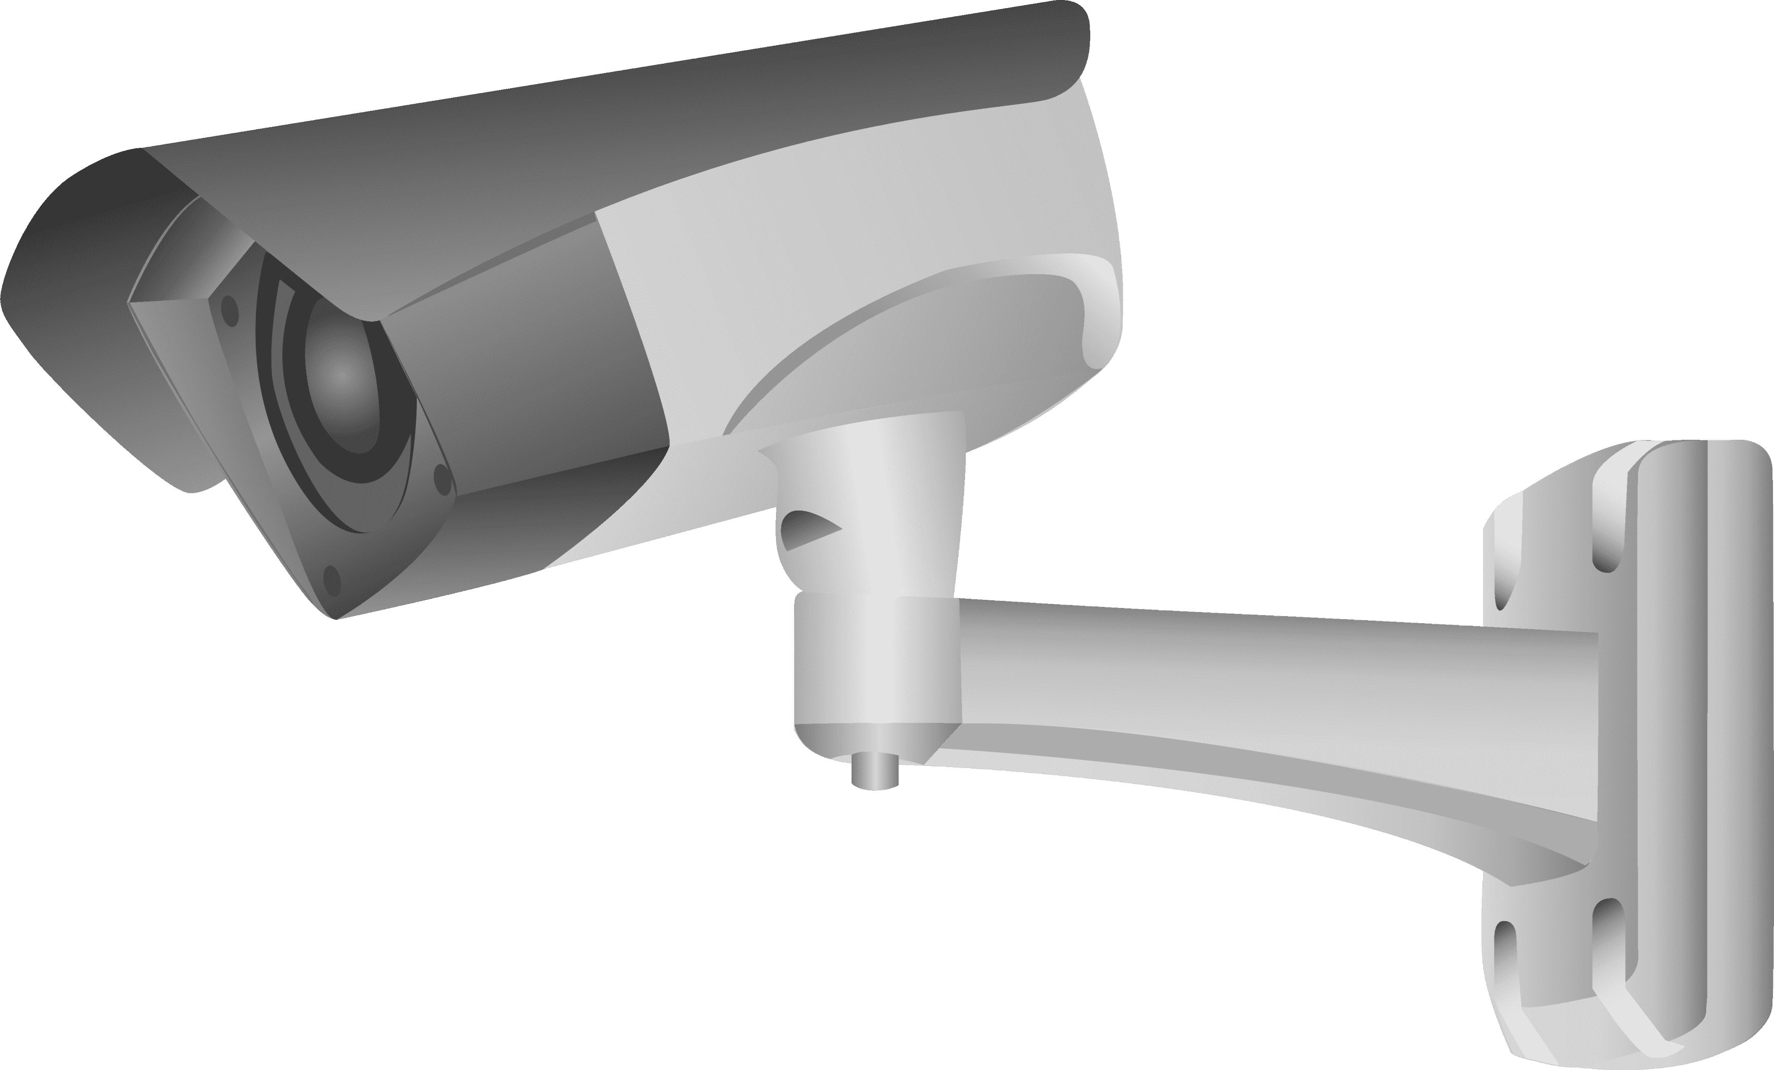



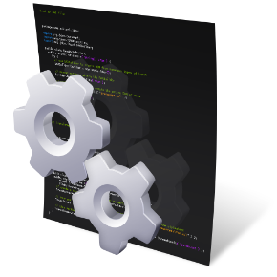
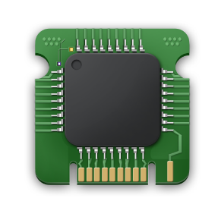
Methodology
Database
Cameras
Violation Records
Analyze Frames for Violations
Send Violation Footages
Capture Traffic
Send Data
Central Server
Vehicle Identification System
Detection Models
Edge Processing Unit
IT21212222 | <<Seneviratne.K.A.C.M>> | <<24-25J-165>>

Slide 11


Used Technologies & Techniques
Technologies
Algorithms
Techniques
Object Detection
Color Detection in HSV Space
Euclidean Distance Calculation
Frame Resizing
Dynamic Line Adjustment
Open CV
Yolo
Flask
Tensor flow
YOLOv5 Object Detection Algorithm
HSV Color Filtering Algorithm
Bounding Box Centroid Calculation
Violation Detection Algorithm

Slide 12


Completion of the Component
Developed the red-light violation detection module using rule-based image processing techniques.
Implemented algorithms to detect traffic light color and monitor vehicle movement during red signals.
Worked on synchronizing camera input with signal status for accurate violation detection.
Collaborated in system integration and testing to ensure reliable real-time detection.
IT21212222 | <<Seneviratne.K.A.C.M>> | <<24-25J-165>>

Slide 13
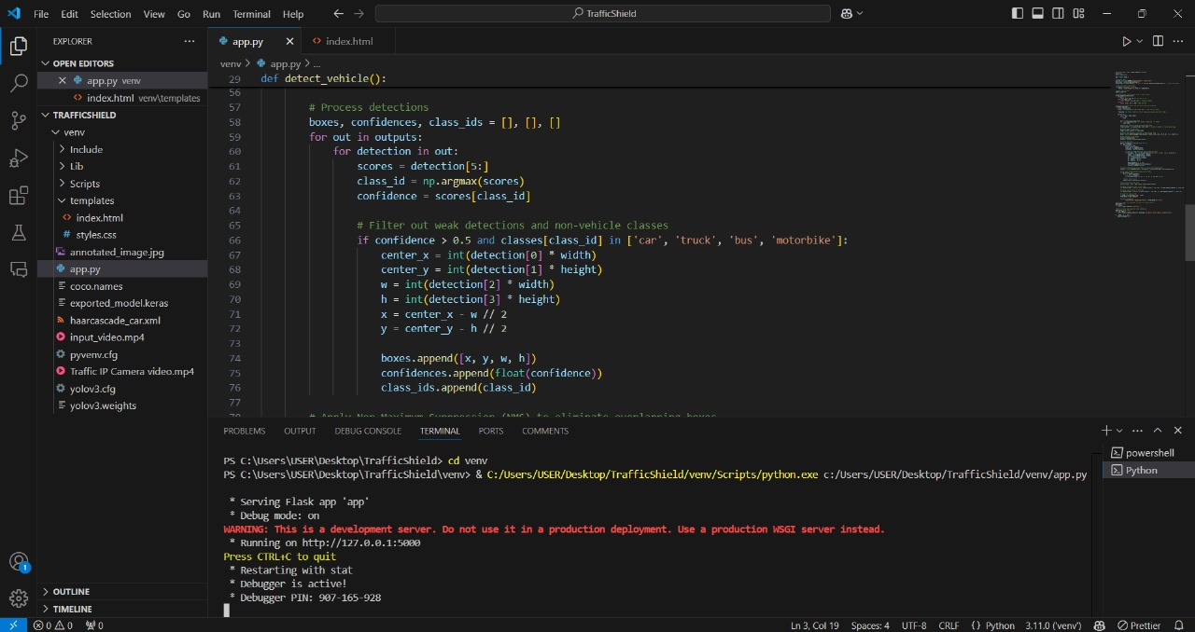
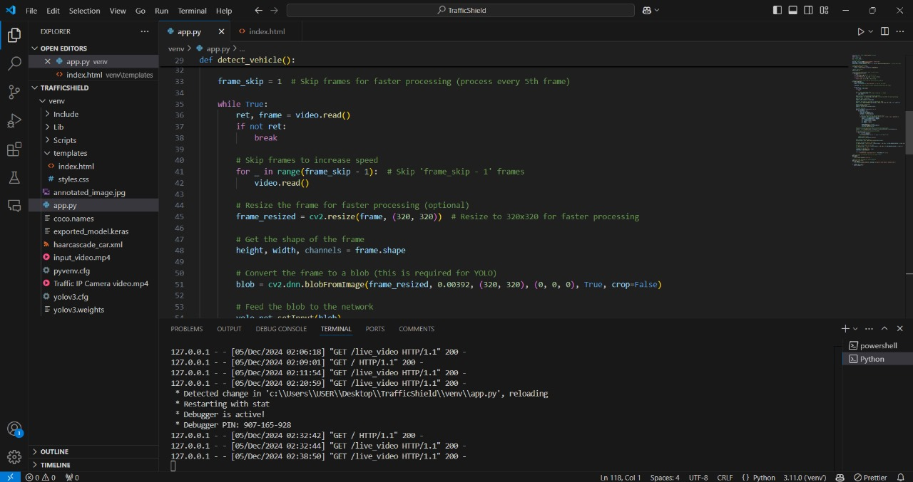
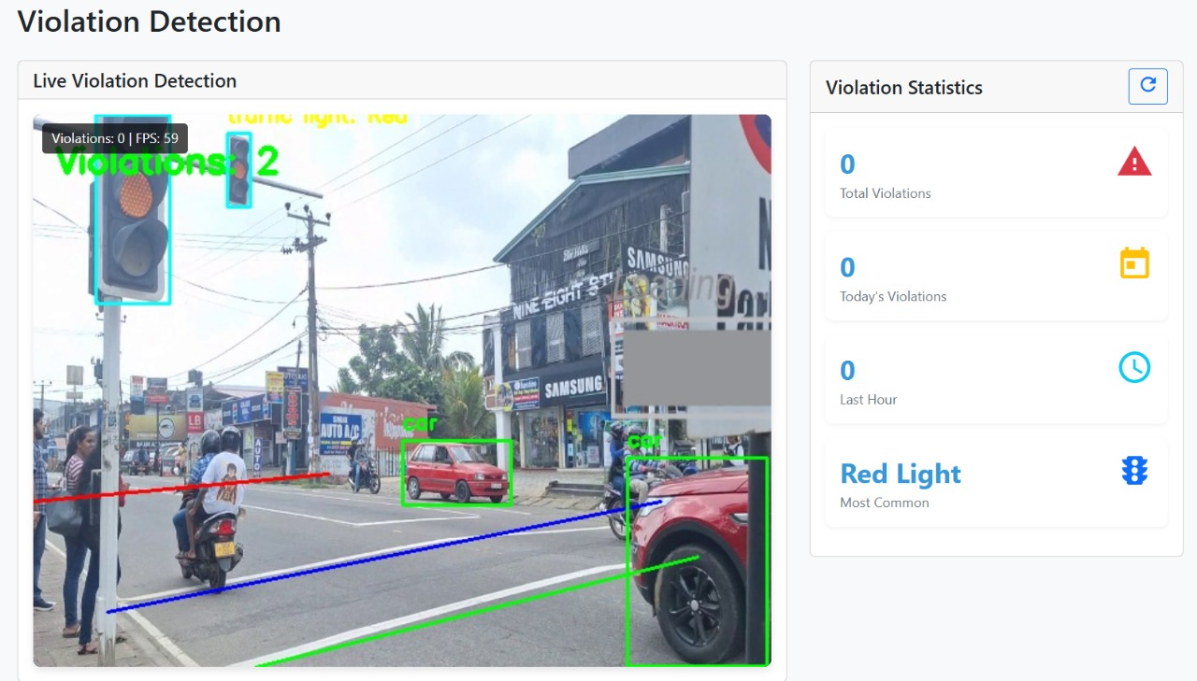
Proof of Work
IT21212222 | <<Seneviratne.K.A.C.M>> | <<24-25J-165>>

Slide 14
Challenges
Detecting traffic light colors in different lighting conditions.
Handling vehicles or objects blocking the view (occlusions).
Synchronizing camera input with traffic light changes.
Managing poor image quality and noise.
Ensuring real-time detection without delays.
Differentiating multiple vehicles crossing at once.
IT21212222 | <<Seneviratne.K.A.C.M>> | <<24-25J-165>>>>

Slide 15

IT21334306 | Wathsala W.H.D
BSc (Hons) Degree in Information BSc (Hons) Degree in Information Technology
Specialized in Information Technology
IT21334306 | <<Wathsala W.H.D>> | <<Project ID>>

Slide 16
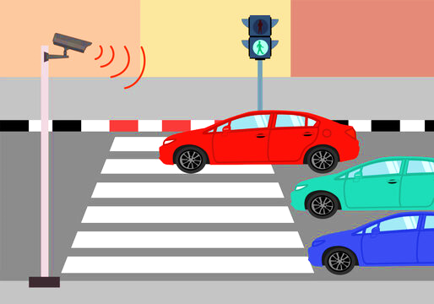
Background
Specialized in image processing techniques.
Developed pedestrian line violation detection module
Implemented number plate detection for
vehicle identification.
Skilled in rule-based algorithms for
traffic monitoring.
Focused on enhancing pedestrian
safety and accurate vehicle data capture.
IT21334306 | <<Wathsala W.H.D>> | <<Project ID>>

Slide 17
Objective
To develop a module that accurately detects pedestrian line violations and captures the number plates of violating vehicles to support automated traffic law enforcement.
Sub-Objectives
Detect the pedestrian crossing area using image processing techniques.
Identify vehicles violating the pedestrian line during restricted signal phases.
Ensure pedestrian safety by monitoring vehicle movement near crossings.
Capture number plates of vehicles involved in pedestrian line violations.
Store violation data with time and vehicle details for reporting purposes.
IT21334306 | <<Wathsala W.H.D>> | <<Project ID>>

Slide 18
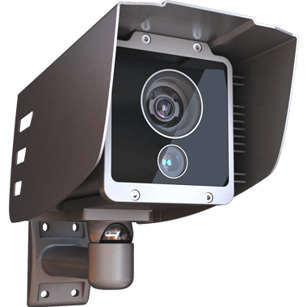







Methodology
Violation Detection Cameras
Database
Capture Violation
Violation Data Records
Main Server
Analize frames for violations
Send violation Footages
Capture Violation
Processing Unit
Detection Models
Crossing line Violation & Backup camera System
IT21334306 | <<Wathsala W.H.D>> | <<24-25J-165>>

Slide 19
Used Technologies & Techniques
Technologies
Algorithms
Techniques
Object Detection
Color Detection in HSV Space
Euclidean Distance Calculation
Frame Resizing
Dynamic Line Adjustment
Open CV
Yolo
Flask
Tensor flow
YOLOv5 Object Detection Algorithm
HSV Color Filtering Algorithm
Bounding Box Centroid Calculation
Violation Detection Algorithm

Slide 20
Completion of the Component
Developed pedestrian line violation detection module
Detected vehicles entering pedestrian crossing during red light
Implemented number plate detection for violators
Integrated module with main system for real-time monitoring
Tested and validated component under various conditions
IT21334306 | <<Wathsala W.H.D>> | <<24-25J-165>>

Slide 21
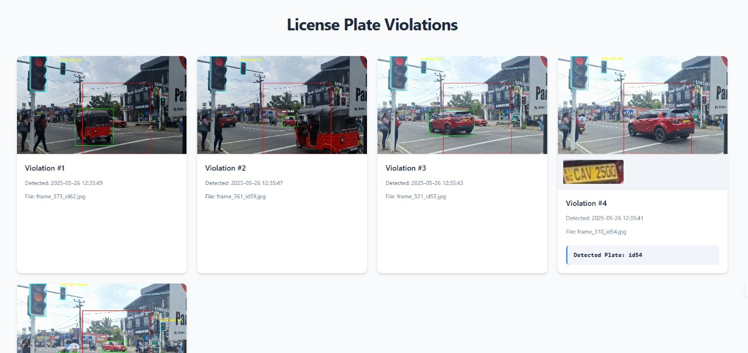
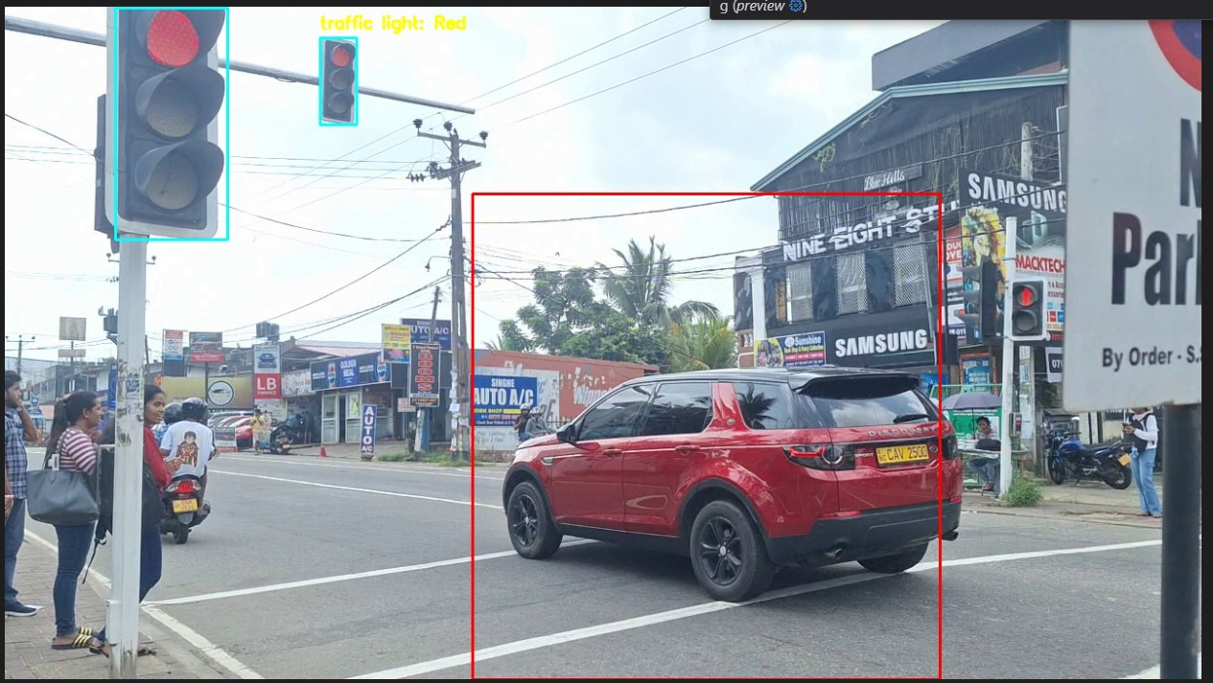
Proof of Work
IT21334306 | <<Wathsala W.H.D>> | <<24-25J-165>>

Slide 22
Challenges
Difficulty in accurately detecting pedestrian crossing lines in varying lighting conditions
Detecting violations when pedestrians and vehicles overlapped in the camera frame
Handling motion blur during vehicle movement
Ensuring accurate number plate detection under poor image quality
Maintaining real-time processing speed without delays
Avoiding false positives in crowded or unclear scenes
IT21334306 | <<Wathsala W.H.D>> | <<24-25J-165>>

Slide 23
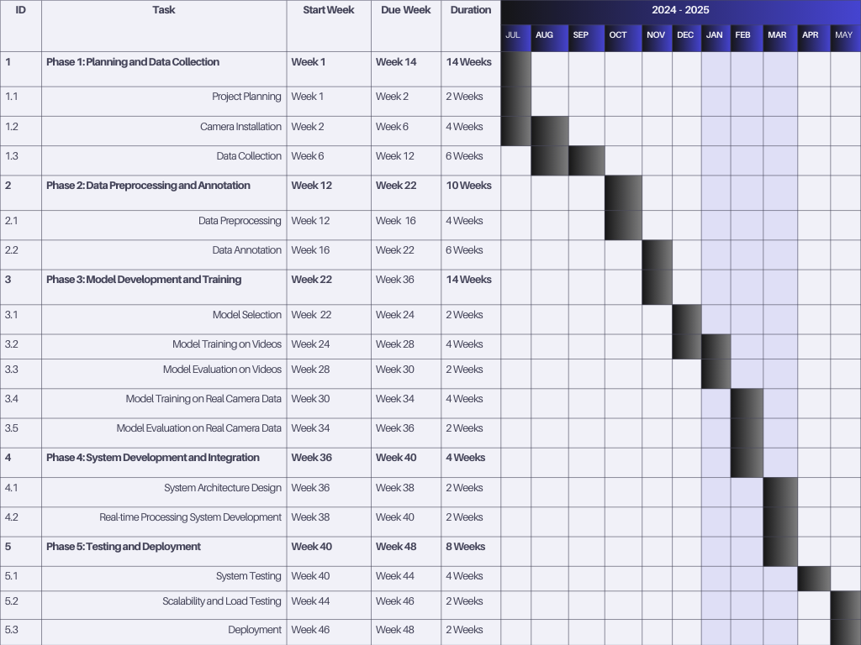
Gantt Chart
IT21334306 | <<Wathsala W.H.D>> | <<Project ID>>

Slide 24
References
https://www.researchgate.net/search.Search.html?query=traffic+detection&type=publication
https://www.researchgate.net/publication/382121395_Traffic_Object_Detection_and_Recognition_Systems
IT21334306 | <<Wathsala W.H.D>> | <<Project ID>>

Slide 25

IT21327926 | Mahindapala.g.h.n.k
BSc (Hons) Degree in Information BSc (Hons) Degree in Information Technology
Specialized in Information Technology
IT2127926 | <<Mahindapala.G.H.N.K>> | <<24-25J-165>>

Slide 26
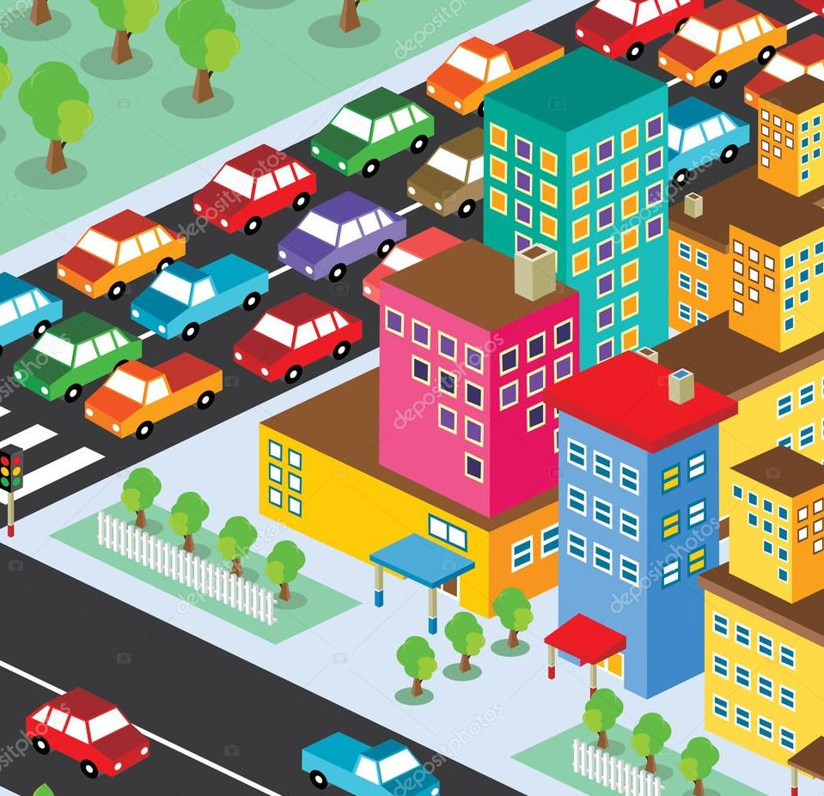
Background
Specialized in system architecture and
integration.
Designed the overall flow and coordination
between system modules.
Developed the backend logic for data handling
and report generation.
Managed hardware-software interfacing for
real-time operation.
Ensured the system functioned smoothly as a unified platform.
IT2127926 | <<Mahindapala.G.H.N.K>> | <<24-25J-165>>

Slide 27
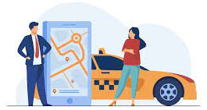
Specific Objective and Sub Objectives
Objective
Develop an integrated system that analyzes real-time traffic data, displays traffic status via LED screens, and automatically reports traffic violations to nearby police stations.
Sub Objectives
Design the overall system flow and coordinate data
between modules.
Integrate red-light, stop-line, and pedestrian line detection modules
into a unified system.
Develop backend logic to handle violation data securely and efficiently
Automate the generation of violation reports with vehicle and timestamp details.
Ensure real-time performance through optimized hardware-software communication.
Conduct system-level testing and debugging to validate end-to-end functionality.
IT2127926 | <<Mahindapala.G.H.N.K>> | <<24-25J-165>>

Slide 28
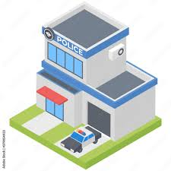

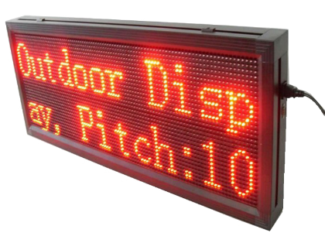
Methodology
Data Base
Cameras
Detected violation data
Refer the updates
Capture Traffic
Reporting Detected Violations
Analyse traffic
Send Data
Central Server
Analyse & Maintaining Profiles
Edge Processing Unit
Web Application
Display Traffic status
LED Desplay
IT2127926 | <<Mahindapala.G.H.N.K>> | <<24-25J-165>>

Slide 29
Used Technologies & Techniques
Technologies
Algorithms
Techniques
Open CV
Yolo
Flask
Web Routing (Flask)
Basic Vehicle Counting (Placeholder)
Real-time Video Streaming.
Frame Annotation.
Web Routing (Flask)

Slide 30
Completion of the Component
Created and collected datasets
Built and trained CNN model for vehicle identification & counting
Ongoing implementation of Traffic Shield web app
IT2127926 | <<Mahindapala.G.H.N.K>> | <<24-25J-165>>

Slide 31
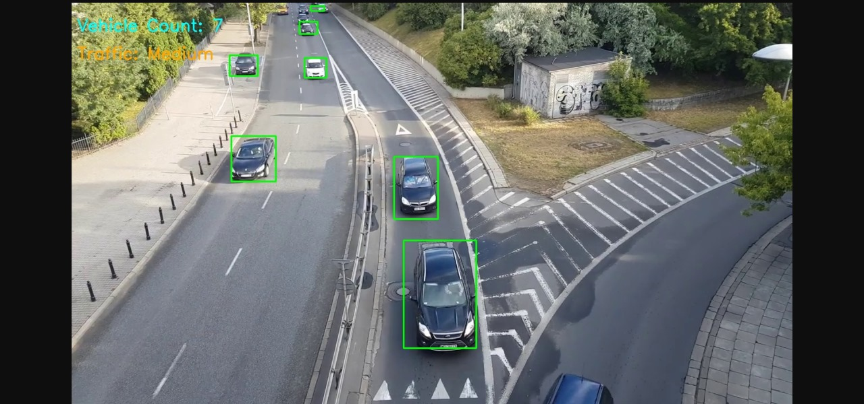
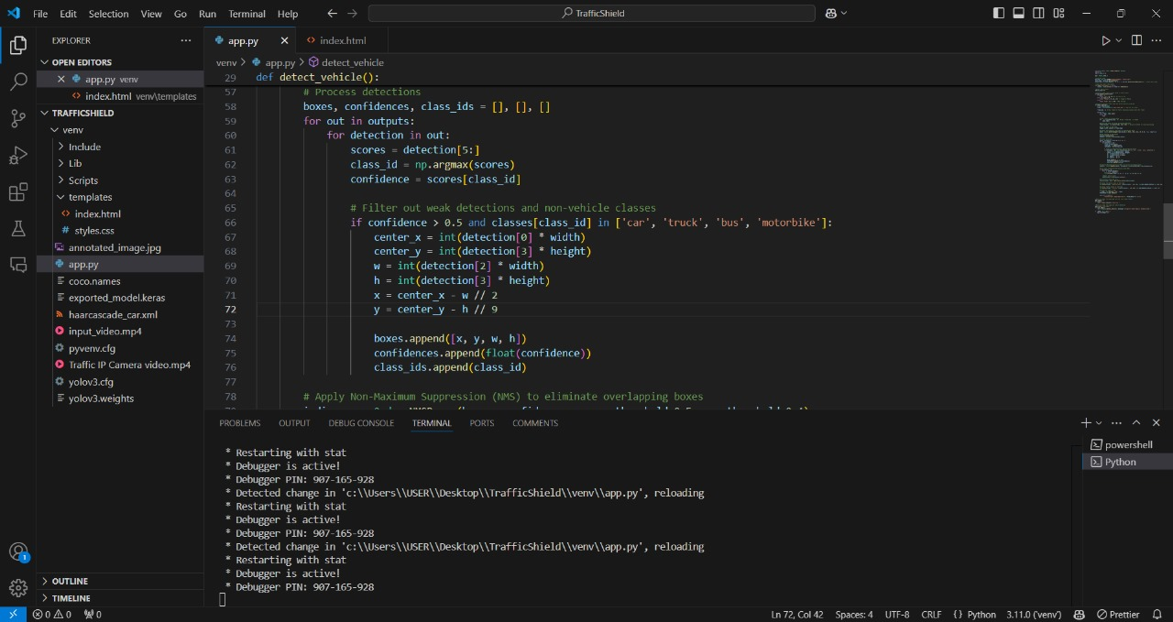
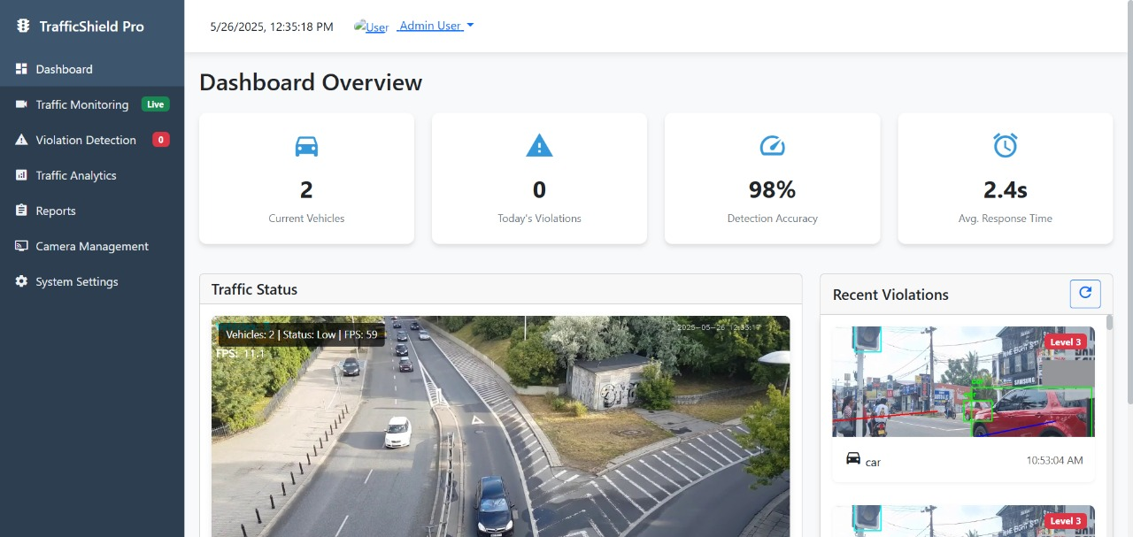
Proof of Work
IT2127926 | <<Mahindapala.G.H.N.K>> | <<24-25J-165>>

Slide 32

Challenges
Integrating multiple modules with different data formats and timings.
Ensuring smooth communication between hardware (cameras) and software components.
Managing data synchronization for real-time violation logging.
Handling delays or data loss in live video processing.
Designing a reliable and secure backend for data storage.
Automating report generation without missing or duplicating entries.
Debugging issues across interconnected components during system testing.
IT2127926 | <<Mahindapala.G.H.N.K>> | <<24-25J-165>>

Slide 33
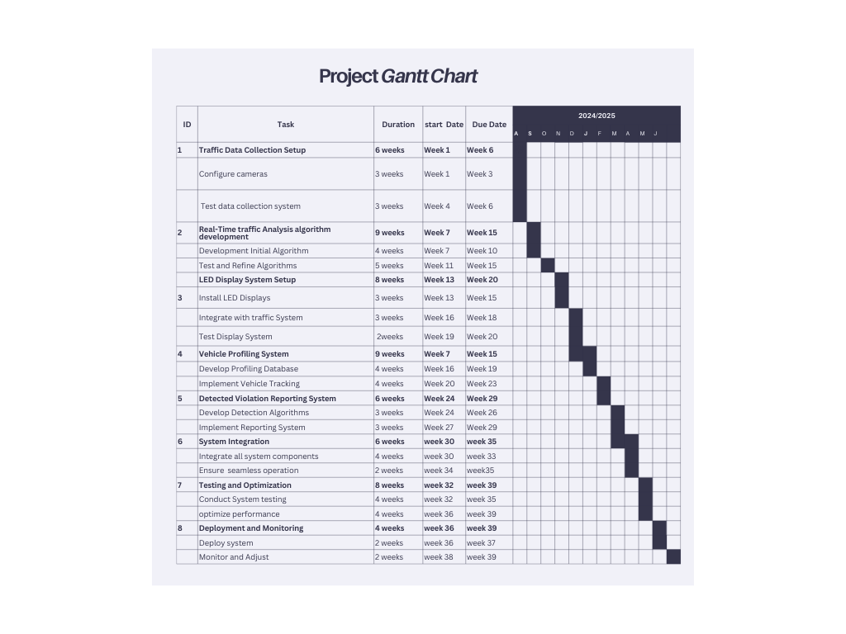
Gantt Chart
IT2127926 | <<Mahindapala.G.H.N.K>> | <<24-25J-165>>

Slide 34
References
Zhang, H., & Liu, H. X. (2013). A review of traffic congestion detection, mitigation, and control. Transportation Research Part B: Methodological, 52, 1-24.
Hartenstein, H., & Laberteaux, K. P. (2008). VANET: Vehicular Applications and Inter-Networking Technologies. John Wiley & Sons.
Sun, Z., Bebis, G., & Miller, R. (2006). On-road vehicle detection: A review. IEEE Transactions on Pattern Analysis and Machine Intelligence, 28(5), 694-711.
Liu, Y., Zhang, Y., & Gao, Y. (2019). A cloud-based IoT framework for intelligent traffic management and violation detection. IEEE Transactions on Intelligent Transportation Systems, 20(1), 308-319.

Slide 35
Thank you

Slide 36


